Slide 1

Foundations of Entrepreneurship
Funding New Venture
Lecture Note # 24
11.03.2021

Slide 2
Funding New Ventures
Section – I: Introduction, funding requirement, possible sources
Section – II: Bootstrapping, crowdsourcing, incubation, acceleration
Section – III: BA | VC
Section – IV: Debt funding
Section – V: Government assistances

Slide 3
Introduction
Requirement of fund
Types of sources of fund
Pros and Cons of various funding

Slide 4
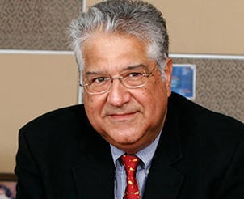
In 1975, Malhotra co-founded HCL Group, where
he served as vice chairman.
Founded TechSpan and served as chief executive officer of US-based firm Headstrong after the two companies merged.
Co-founded SPIC MACAY along with his college friend Kiran Seth for the promotion of Indian music and culture amongst youth.

Slide 5
Malhotra started his career in 1970, when he joined Delhi Cloth Mills as Senior Management Trainee. In 1972 along with Shiv Nadar he was assigned to set up marketing division for DCM Data Patterns to sell pocket calculators. In 1975, he quit DCM and partnered with Shiv Nadar, Ajai Chowdhry, D.S. Puri, Yogesh Vaidya and Subhash Arora to set up a company known as Microcomp Limited, which sold digital calculators, eventually becoming its Vice Chairman. Microcomp created a joint sector company named Hindustan Computers Limited and began manufacturing mini and microcomputers. He led the company's joint venture with Hewlett Packard in India and also companys Hong Kong, Australia, and New Zealand business operations. He took over HCL's US operation in 1989.
Malhotra, along with Sandeep Sahai, Nagesh Mehra, Puneet Pushkarna, Aloke Paskar, Curt Terwilliger, Harsh Lohit, Adarsh Mehra, and Bonnie Singh started his IT consulting company TechSpan in 1998 with funding from Goldman Sachs and Walden. He later merged the company with IT services company Headstrong in 2003, and became that company's CEO. HeadStrong was later acquired by Genpact for US$550 million in 2011. Malhotra was described by Business Today as a "serial technology entrepreneur" who "was ahead of the learning curve" with each of his companies. He setup Magic Software, a software company in 2011. He serves as director for various other companies including Lumis Partners, Evolko Inc, Mapmygenome and Number Theory Software, an artificial intelligence and data science solution provider.
He is Chairman of Board of Vision 2020, an IIT Alumni lead initiative to help IIT raise endowment funds. He is on Board of Governors of IIT - Foundation (Kharagpur), Indian School of Business Hyderabad, IIM Udaipur, IIM Shillong. member of Indian Public Schools Society that runs the Doon School. He is also Executive Council member of NASSCOM.

Slide 6
Shiv Nadar
Hails from rural settings
Engg. from SPG College
Started career in Delhi Cloth Mill Calculator division.
He met Arjun Malhotra and 4 others at DCM
They started ‘Microcomputer’ under ‘Televista’ brand to market microcomputer.
At a time when India had just 250 PCs, UP Electronic Corporation invested 26% eq. to set up Hindustan Computers Ltd. to compete with IBM (contemporary of Apple)
1977 Janata Party came to power George Fernandes expelled American companies IBM etc.
1978 HCL successfully developed and shipped first in-house Micro computer – concurrently with Apple.
1979 Opened manufacturing in Singapore
1981 – Started NIIT
1983 Developed Networking Operating System and Client-Server Architecture
1985 introduced Unix based ‘Busybee’
1989 HCL America launched
1991 HCL-HP launched in USA
1994 Joint venture with Nokia and Ericsson to exploit marketing network
1997 Software outsourcing for foreign countries
1998 Arjun Malhotra quits
1999 IPO
2001 Largest BPO in Ireland
Zero visibility landing for Boeing
2008 Padma Bhushan award
Exploiting the change in the environment is the characteristic of great entrepreneur

Slide 7
Capital is the “lifeblood” of a new venture.

Slide 8
IPO/ Private Equity
Angel
High net worth individuals
Early stage VCs
VCs
Debt from banks/ Fintech
Incubators
Accelerators
Crowd funding
Growth strategy
Set up offices
Warehouses
Recruit more people to handle growth
Capture data, use analytics to know customer-satisfaction/ repeat customers
Refine products
Price strategy
Business process management
Recruit professional CEO and other C-suits
Continuous value addition, new product development, maintain superior value proposition
Equity
Family
Friends
Go-to-market strategies
Infrastructure for product or service creation
Set up Logistics for both inputs and sales
Begin awareness campaign
Recruit manufacturing, marketing, and service personnel
Build shopping portal
Setup Payment Gateway
Product development and validation
Define value proposition/ product differentiation
Decision to be entrepreneur – is primarily driven by your passion to alleviate a pain
Idea, market research, prototype
Company registration

Slide 9
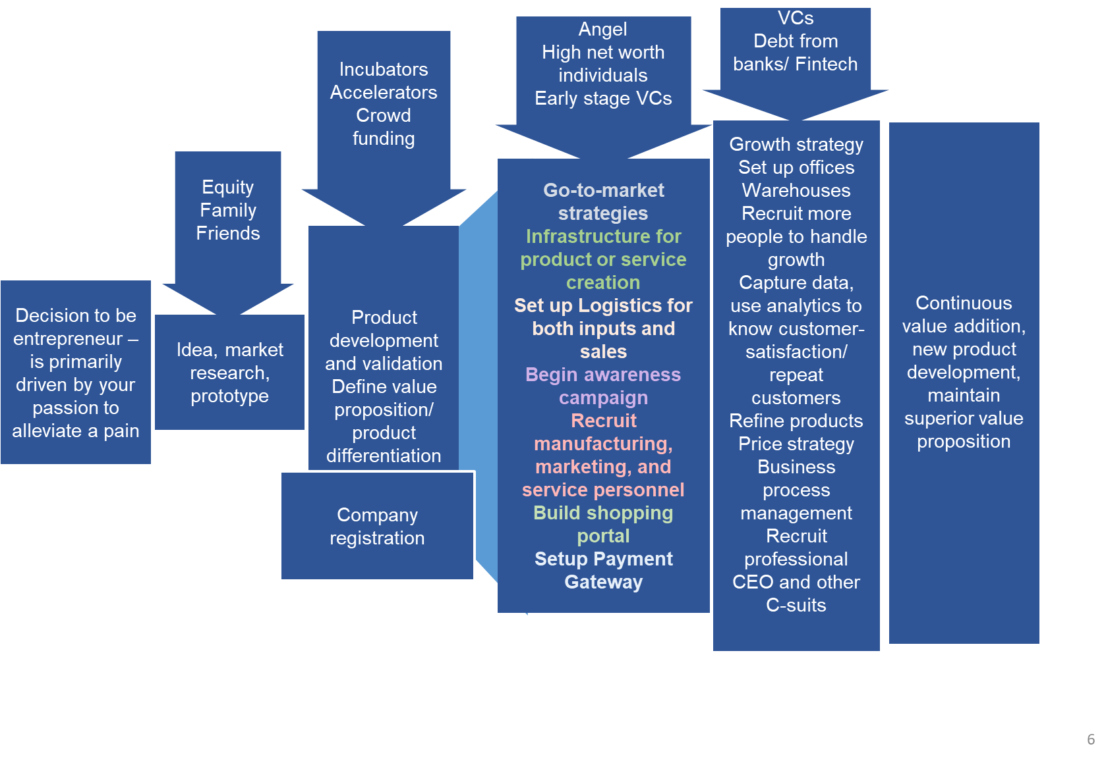
Movement of funds
Movement of goods
Banks
Current account
Short-term loan
Purchase of inputs (raw-materials)
Shop floor
Goods under process
Finished goods inventory
Dealers/ Distributors
Retailers/ customers
Bank
Long-term loan
Accounting – Financial statements
Inventory management, manage cash flow, arrange fund in time
Human resource – recruitment, integration, reward/remuneration, career development, payroll.

Slide 10
Funding Decisions are Very Tricky
We hear stories of venture capitalists making nX returns from funding startup that achieve remarkable success.
Peter Thiel invested $500,000 in Facebook in 2004. Eight years later, he sold his stake for more than $1 billion.
But still many entrepreneurs face multiple rounds of rejection.
The success depends on attractiveness of the business model, timing, traction, team, and prospect.

Slide 11
For example, Joe Gebbia, Brian Chesky, and Nathan Blecharczyk sought funding for their startup, Airbnb, in 2008.
They wanted to raise $150,000 in return for a 10 percent stake in their company.
Nine years later, Airbnb, was valued $31 billion.
If one of these investors had invested, their $150,000 investment would have been worth $3.1 billion in nine years.
Even the most accomplished venture capitalists invest in many startups that do not succeed and pass on a number of deals that could have been highly lucrative.
Every investor has at least one great regret.

Slide 12
Forms of Capital
Forms of capital – equity, preference shares, debt, grant
Equity investment gives ownership to investors
Investment in preference shares may have equity or debt or both flavours.
Debt is loan taken on interest and has to be repaid – no matter what.
Grant has no covenant.

Slide 13
Expenses before going to market:

Slide 14
For what purposes a startup requires money?
Once you are ready with you product, you need major amount of fund to
Create infrastructure.
Working capital.
Sales promotion.
Brand building.
Logistics.
Post sales service.
Employee benefits.
Website/app development
Team hiring
Legal and consulting services for your startup
Licenses and certifications
Marketing and Sales
Office space and other admin expenses

Slide 15
Sources and Uses of Capital Balance Sheet
Assets
Cash
Trade receivables
Inventory
Land
Building
Machinery
Equity & Liabilities
Equity capital
Reserves & surplus
Preference capital
Trade payable
Short-term debt
Long-term debt

Slide 17
Face value or per value: Say
₹10
2 lakh shares of ₹10 each

Slide 18
Authorized, Fully and Partly Paid-up Capital
Post- and Pre-money value

Slide 19
Equity Holding
Equity & Liability
Equity capital – fully paid-up equity capital | Consisting of 2 lakh equity shares of face value ₹ 10 each. | Total equity capital: ₹ 20 Lakh i.e. 2 L shares
Co-founder A holds | 50,000 shares | 50,000/2,00,000 = 25% holding
Co-founder B holds | 80,000 shares | 80,000/2,00,000 = 40%
Co-founder C holds | 70,000 shares | 35%
 |  | Total 100%
Shares provide you voting right

Slide 20
Equity Holding
Number of shares held by the co-founders will not change. Therefore, to offer 20% of equity post-money, your combined holding will go down to 80%. So, post-money, number of shares is 2,00,000/0.8 = 2,50,000 number of shares
Equity & Liability
Equity capital – fully paid-up equity capital | Consisting of 2 lakh equity shares of face value ₹ 10 each. | Total equity capital: ₹ 20 Lakh i.e. 2 L shares
Co-founder A holds | 50,000 shares | 50,000/2,50,000 = 20% holding
Co-founder B holds | 80,000 shares | 80,000/2,50,000 = 32%
Co-founder C holds | 70,000 shares | 70,000/2,50,000 = 28%
Investor | 50,000 shares | 50,000/250,000 = 20%
 |  | Total : 100%

Slide 21
Equity Holding
Founder A: 20%
Founder B: 32%
50,000 shares out of total of 2,50,000 shares issued.
A
B
80,000 shares out of total of 2,50,000 shares issued.
Founder C: 28%
Investor: 20%
70,000 shares out of total of 2,50,000 shares issued.
C
Investor
50,000 shares out of total of 2,50,000 shares issued.

Slide 22
An Investor Can Invest in Equity, Preference Shares, Debt, Grant. Seniority of Creditors
If a company goes into liquidation, the sales proceeds of all its assets are distributed among all creditors and equity holders.
Secured creditors are served first.
Next are unsecured creditors and employees.
Preference shareholders
Stockholders are paid last.

Slide 23
Raising money is an essential part of early stage entrepreneurial ventures
Most new entrepreneurs do not have enough money to fund the exact need of the business.
Unlimited risk.
Capital investment.
Cash flow challenges.
Long duration of product development and creation of market connectivity.
Growth of business entails large amount of money.
Money from external source somewhat reduces risk.

Slide 24
Startups Need Risk Capital at the Early Stage
Risk perception
Valuation
Successful ideas
Only a few ideas are translated into commercially relevant technologies and a very few of them reach the customers.
Some sustain for a long time, some quickly extinct.
Number of ideas
Risk perception
Product Dev. Life Cycle

Slide 25
How Much Money You Need?
In billion dollar

Slide 26













Progress & Valuation
Scale company +
Seek Profitability
Provide Exit to
Investors - IPO
All icons are from: https://www.flaticon.com
Set strategy for repeatable model
Public issue
Series-A round
Get the product
Customer Validated
Angel round
Value of the startup
Develop the Idea
& Business model
Build the
Product
Friends & Family
Bootstrap
Bootstrap
IPO
100
50
50
26
Equity Holding %

Slide 27
Progress & Valuation
Public issue
Series-A round
All icons are from: https://www.flaticon.com
Angel round
Value of the startup
Friends & Family
Cofounder stage
Idea stage
IPO
100%
50
50

Slide 28
Progress & Valuation
Public issue
Series-A round
All icons are from: https://www.flaticon.com
Angel round
Value of the startup
Friends & Family
Cofounder stage
Idea stage
IPO
100%
50
50

Slide 29
Progress & Valuation
Public issue
Series-A round
All icons are from: https://www.flaticon.com
Angel round
Value of the startup
Friends & Family
Cofounder stage
Idea stage
IPO
100%
50
50

Slide 30
Progress & Valuation
Public issue
Series-A round
All icons are from: https://www.flaticon.com
Angel round
Value of the startup
Friends & Family
Cofounder stage
Idea stage
IPO
100%
50
50

Slide 31
Progress & Valuation
Public issue
Series-A round
All icons are from: https://www.flaticon.com
Angel round
Value of the startup
Friends & Family
Cofounder stage
Idea stage
IPO
100%
50
50

Slide 32
Progress & Valuation
Public issue
Series-A round
All icons are from: https://www.flaticon.com
Angel round
Value of the startup
Friends & Family
Cofounder stage
Idea stage
IPO
100%
50
50

Slide 33
Progress & Valuation
Public issue
Series-A round
All icons are from: https://www.flaticon.com
Angel round
Value of the startup
Friends & Family
Cofounder stage
Idea stage
IPO
100%
50
50

Slide 34
Your holding in the company gets diluted as you obtain investment in the form of equity.
Debt does not dilute equity, but have to be repaid with interest.
Grant is the most attractive form of capital.
Some private organizations also provide grant.
For example: Villgro: www.villgro.org
Villgro is India's oldest and foremost social enterprise incubator, that supports social startups in the sectors of Agribusiness, Health, Education and Renewable energy.

Slide 35
Security: In Two Contexts
Securing a debt (loan)
Securitization of assets
Hypothecation
Mortgage
Lien
Pledge
Guarantee
A document holding the right on a property.
A fixed deposit certificate
A share certificate (equity & preference share)
A bond certificate
You offer assets as security to secure a debt so that the lender can liquidate the assets to recover the loan in the event you fail to repay as promised.
Lenders’ motivation to extend the loan depends on the value and liquidity of the assets that you pledge.
Assets other than what is financed by the loan and offered as security is known as collaterals.

Slide 36
This knowledge is important because investors’ risk perception depends on the type of security that they receive.
Furthermore, it is important to know that in the event of liquidation, the equity holders (the founders) may not receive anything if the proceeds are inadequate to meet all other liabilities.

Slide 37
Seniority Ranking of Corporate Liabilities
Secured Creditors
Claim by the government
Credit secured by collaterals (Bank loans)
Subordinated (Subordinated bonds and loans)
In finance, seniority refers to the order of repayment out of salvaged value in the event of a sale or bankruptcy of the issuer. Seniority can refer to either debt or preferred stock. Senior debt must be repaid before subordinated (or junior) debt.
Unsecured Creditors
Unsecured (Public deposits, corporate bonds, corporate papers, trade creditors)
Preference shares (Hybrid/quasi equity)
Mezzanine
Preference shareholders
Seed capital
Equity
Equity
Subsidy, grant,

Slide 38
Types and Sources of Funds
Grant, subsidy, donations (no cost and no obligation to return).
Seed money (Zero to low cost, vary from grant to debt)
Equity (cost obligation: dividend & capital appreciation, no repayment)
Founders/promoters, accumulated surplus (profit)
Investors
Friends & relatives
Public
Preference equity (Mostly hybrid in nature: mix of Debt and Equity)
Unsecured loan (mezzanine senior to equity but subordinate to secured debt)
Most costly
Debt, Trade creditors
Long-term debt
Banks/financial institutions, private lenders, trade creditors, non-bank finance companies
Short-term debt
Mostly banks
Seniority

Slide 39
Seniority of Sources (Nature) of Funds/ Seniority of Liabilities
Seniority in the context of various types of sources of fund refers to the priority or order of payment (or repayment) in the event of liquidation of an enterprise.
Seniority pertains to debt (loans, bonds, securities), preferred stock, various credits, and equity. Every security has relative seniority. Some securities such as bonds may be of same seniority, which is termed as pari passu.
Say, based on court order, the assets of a company are being liquidated and the proceeds are to be distributed among all the creditors (banks and others).
The senior most debt must be repaid before subordinated (or junior) debt is repaid.
Preferred stock (preference capital) is senior to common stock (equity capital), which means that preference stock holders will be paid first. If anything is left after paying to preference shareholders, only then equity shareholders will be paid.

Slide 40
Example
A company defaults on payment to a creditor and the court orders liquidation. How the payment will be made and will there be anything for the equity holder? Suppose, the following is the list of creditors and their receivables.
Creditors | Outstanding
Trade creditors | 200
Unsecured loans | 300
Bank loan | 1000
Preference stocks | 500
Loan on second lien (mortgage) | 200
Total | 2200
Liquidation proceeds: |  | 1500 | 1300 | 2500
Bank loan | 1000 | 1000 | 1000 | 1000
Loan on second lien (mortgage) | 200 | 200 | 200 | 200
Trade creditors | 200 | 200 | 100 | 200
Unsecured loans | 300 | 100 | 0 | 300
Preference stocks | 500 | 0 | 0 | 500
Equity holders |  | 0 | 0 | 300

Slide 41
How to Fund Your Startup?
Bootstrapping (own sources including credit cards)
Friends & Family
Crowd-Funding/sourcing
Startup competitions
Impact Investors – Example: VillGro
Incubators (mostly university based)
Startup Accelerators (Surge by Sequoia Capital)
Angel Investors
Venture Capitalists
Private Equity
Bank Loans
Advance/ Pre-payment from future customers
Startup-Specific Credit Card: Example: LaghuUdhyami Card from IDBI
Government Institutions – Example: DSIR, SIDBI, NABARD and MSME (NSIC)
Indian government Startup Funds: India Aspiration Fund (IAF), SIDBI SMILE, Mudra Fund
Government grants: visit
startupindia.gov.in

Slide 42
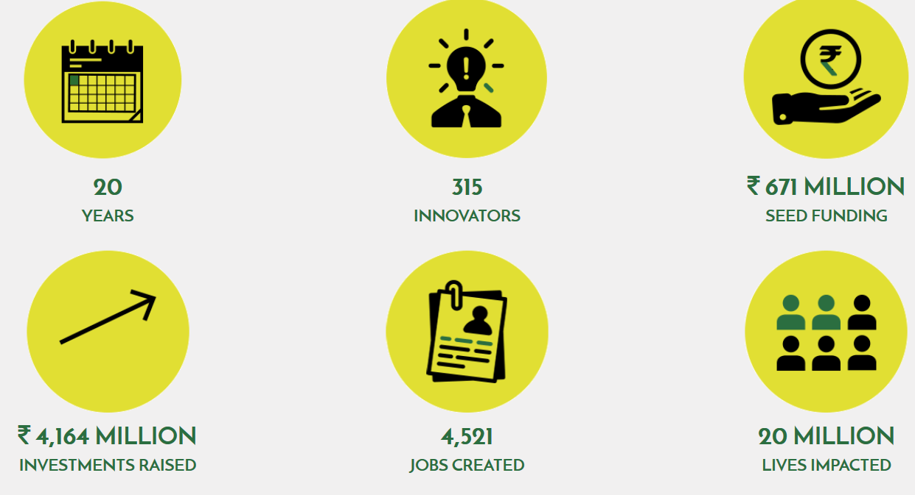

Slide 43
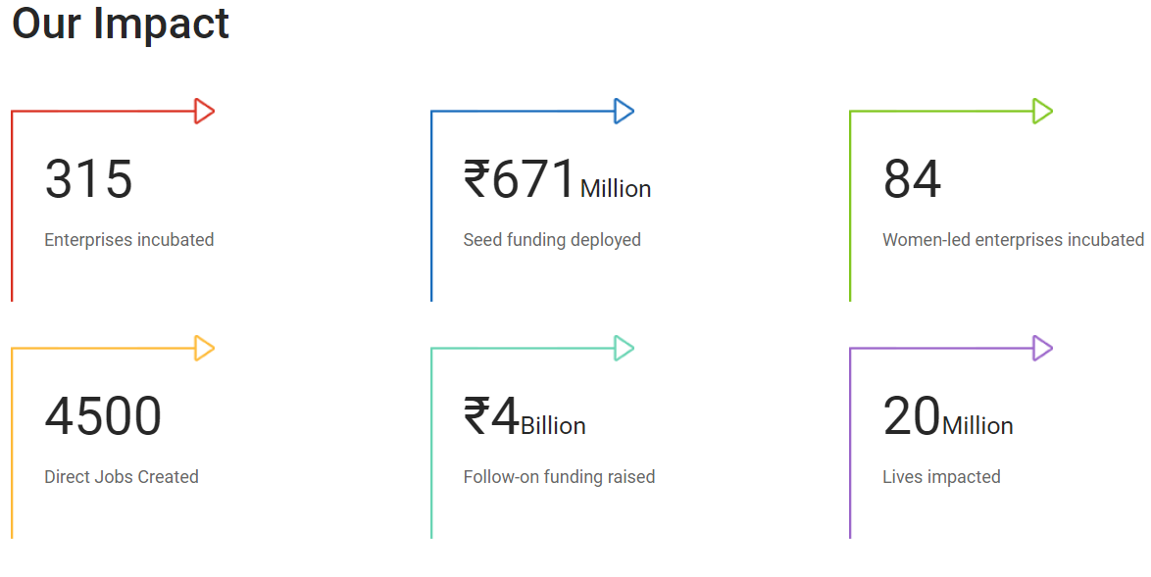

Slide 44
Loan or Debt
Loans are primarily of two types
Long-term – for capital assets (useful life longer than a year)
Short-term – for working capital
Securities are of two types
Primary (charge on the assets funded by the loan)
Collateral (charge on assets other than those acquired with the loan)
Seniority of a loan or type of fund primarily depends on: whether it is secured or unsecured and is it primary or subordinated debt.

Slide 45

Funding Requirement and Structure Change with Stages of Life-Cycle of the Enterprise
Set strategy
for repeatable
model
Scale company
+
Seek Profitability
Provide Exit to
Investors - IPO
Get the product
Customer
Validated
Debt
Build the
Product
Growth Phase
Develop
the Idea
& Bisiness
model
Strategic
investors
Mid & Late
Stage VC
Organizational Growth/
Cash flow
Early
Stage VC
Angels &
Angel Groups
Seed Stage
& Incubators
Friends &
Family
Bootstrap
Period of operation

Slide 46
What Is Dilution
Extent of dilution in a round of funding depends on valuation of your startup. Value of your startup goes up:
as you move forward with development of your product, and as the risk perception on the success of your venture reduces.
At idea stage, success appears uncertain. Value is very low.
As you get your product customer validated, risk of success appears to reduce and valuation becomes higher.
Early investment leads to higher dilution of equity because of lower valuation (though it may help in accelerating development), whereas, delay in raising money may lead to loss of opportunity (though it may help restrict dilution).

Slide 47
As you gain traction, risk reduces and valuation goes up
Risk perception on the startup
Valuation of the startup
Idea
Prototype
Proof of concept
Basic infra
Seed marketing
Go-to-market

Slide 48
Understand Dilution Suppose you raise ₹ 1 million from angel investor in exchange for equity. Likely dilution of equity for raising this sum at different stages of your start up?
Idea
Initial Prototype
Seed marketing
Proof of concept
Place basic infrastructure
Go-to-market
1 million for 25%
1 million for 20%
1 million for 10%
1 million for 1%
1 million for 0. 1%
1 million for 0.01%
Value: 3 mn
Value: 4 mn
Value: 9 mn
Value: 99 mn
Value: 999 mn
Value: 9999 mn
At idea stage, the value of the company is low, say ₹3 million. The angel would invest ₹ 1 million for 25%
As a prototype is built, the value of the company grows to, say ₹4 million. The angel would invest ₹ 1 million for 20%
With the proof of concept, the value is much greater, say ₹9 million. The angel would invest ₹ 1 million for 10%

Slide 49
Dilution and Speed of Development To obtain investment or not to obtain investment

Slide 50
Consider two scenarios: A. Say you plan to delay the fund raising till the point B hoping that the cash flow will follow the brown dotted line.
But if your burn rate is more than you expect, your cash flow may actually follow the red dotted line.
B. Suppose you raise fund at point A. With more fund at your disposal, you move in an accelerated pace and things may take a positive turn.
B
A
Dilution: Say 20%
Two points of entry of investor
Early phases of a start-up
Dilution: Say 40%
Loss of opportunity

Slide 51
When you can say you are ready to raise fund?
Promising concept
Validated by early customers
You are sure that additional fund can take you to the next phase.
Typically, angels or seed stage VCs provide this kind of capital.
But they prefer to invest in ventures located within particular area.
They usually take an active role in the ventures they fund.

Slide 52
The Making Of BYJU'S: The World’s Most Valuable Edtech Company
“There were no investors in the beginning,” Byju says candidly. “And, that was very useful. This helped us patiently create enough, in-depth and comprehensive content. We initially prepared content for 8th to 12th-grade students. We kept on creating content yet we didn’t launch them before 2015.”

Slide 53
Understand Debt, Equity, & Preference Shares
Equity & Liabilities
Equity
Equity share capital |  | Voting rights, % control of the venture, dividends
Reserves & Surplus |  | Belongs to the owners but no other rights
Preference share capital |  | Quasi equity, have features of both debt & equity Compulsory dividend provided there is surplus
Liabilities
Long-Term Loan |  | Debt: Have to pay interest. Repayment by installments. Interest is to be paid on monthly basis on outstanding.
Short-Term Loan |  | Debt: Have to pay interest. Repayment on demand not by installments. Interest is to be paid monthly on weighted outstanding balance.
Accounts Payable |  | Your bargaining power.

Slide 54
Investors Prefer to Invest in Preference Shares or Convertible Debt

Slide 55
Salient Distinctions between Preference Shares and Common Equity Shares
Preference Shares (PS)
Common Equity Shares (CES)
Dividends are paid before paying to common equity holders.
Dividends are accrued and paid when surplus is generated.
Rate of dividend is fixed.
Convertible preference shares may be converted to equity shares.
PS holders do not have voting rights in management decisions.
PS may be redeemed.
In case of liquidation or bankruptcy, PS holders are paid before CES. Limited upside.
Dividends are paid out of surplus/net profit after paying to preference share holders.
Varies with surplus and declaring such dividend is prerogative to BoD.
Dividends are paid out of surplus and is never accrued for paying in future.
A company may buy-back CES.
CES holders participate in management through their right to vote on resolutions.
The entire surplus after meeting other liabilities is distributed among CES holders. Unlimited upside.

Slide 56
Equity Funds
money is invested in the business in exchange for part ownership
Debt Funds
borrowed money, which is paid back over time with interest
Exit through IPO or acquisition
Cost: No interest, dilution
Part ownership
Mentoring and supervision
Security: No security
Repayment
Cost: Interest and charges
No ownership
Covenants
Security: Charge on assets plus collaterals
Claim on assets senior to the common share holders
Government grant – No cost, in some cases no dilution, non-returnable
Hybrid securities (preference share/stock/capital) – Features of both equity and debt
Convertible bond/stock/

Slide 57
Bootstrapping
Crowdfunding

Slide 58
Bootstrapping

Slide 59
Bootstrapping
The dictionary meaning: “get (oneself or something) into or out of a situation using existing resources.”
Some say that bootstrapping is to pulling oneself up by own bootstraps.
Arrange money from any source other than formal investors and lenders.
It starts with personal savings, cutting costs to minimum, sharing office space, traveling by the cheapest option, hiring intern instead of regular employees, getting work done by freelancers, using used instead of new machines, minimize personal expenses avoiding unnecessary expenses, trying to obtain payment in advance or as early as possible, applying for grant wherever possible, etc.

Slide 60
Funding by Bootstrapping
#
#
#
#
#
#
#
#
personal savings
sharing office space
traveling by the cheapest option
hiring intern instead of regular employees
getting work done by freelancers
using used instead of new machines
applying for grant wherever possible
trying to obtain payment in advance or as early as possible

Slide 61
Crowdfunding

Slide 62


Crowdfunding

Slide 63
Crowdfunding
The global crowdfunding industry generated about $34.4 billion in capital last year.
The biggest player in the Indian market is ‘Milaap’, which has raised the equivalent of over US$12.7m through donations and microloans. Spread across close to 50,000 projects, it has averaged around just $260 per project.
Ketto charges 5 to 8% of the amount raised.
https://crowdsourcingweek.com/blog/indias-top-ten-crowdfunding-platforms/

Slide 64
Crowdfunding – Fund Raising Through a Online Platform
Refers to raising money from scores of individuals or donors to fund the development of a product or service and take it to market through setting up a startup.
Some details about the product or service, progress made and the planned roadmap are shared with people for them to make an informed decision to give the money.

Slide 65
Reward-Based Crowdfunding
Entrepreneur propose to reward potential investors / donors with their upcoming product or services or certain benefits
If the founders are in businesses such as apparel, bags, jewelry, beauty products, lifestyle products and personalized stationery, they get valuable feedback in the process of response.

Slide 66
Other Types of Crowdfunding
Equity-based Crowdfunding – not legal in India
Lending-based Crowdfunding
Pre-order Crowdfunding
Donations Or Social Crowdfunding

Slide 67
India has seen a rapid growth of crowdfunding platforms.
The quantum of money raised through these growing number of platforms has also grown substantially.
Besides the much needed capital, a startup may receive vital feedback about the acceptability or attractiveness of their product from a large audience with limited efforts early on.

Slide 68
 | Total Raised | Supporters | Platform Fee | Payment Fee | Important features
GoFundMe | $5B | 50M | 0% | 2.9%+$0.30 | Protects against fraud
INDIEGOGO | $1.5B | 10M | 5% | 3.0%+$0.30 | Do
KICKSTARTER | $3B | 15m | 5% | 3.0%+$0.20 | No
WISHBERRY
FUELaDREAM
FUNDABLE
CATAPOOOLT
Some Crowdsourcing Platforms

Slide 69
Crowdfunding/ Crowdsourcing of Capital
Type of crowdfunding model
Features and performance
Trust and fraud protection
Customer support
Fees
Personal fund raising
Business or project fundraising
Charity/non-profit crowd funding
How fast you can access
All crowdfunding websites are required to use encrypted Secure Socket Layer (SSL) technology to process payments
Reporting fraud should be easy.
24/7 email support.
Mostly between 3 to 5%. But some platform charge up to 30%.

Slide 70
Advantages & Disadvantages of crowdfunding
Advantages
Disadvantages
Usually easy to raise fund
The crowd does not interfere
Usually not associated with dilution
Validation of product or service
Usually requires a social dimension.
Have to build the story to resonate with investors
Risk of sharing the product idea to public too early and run the risk of me-too copy-cat competition
Not suitable for B2B

Slide 71
Crowdfunding in India
Any kind of fund raising from the public is to be authorized by SEBI (Securities & Exchange Board of India).
SEBI is yet to put in place formal regulatory framework for crowdfunding.

Slide 72
Microfinance
‘Rang De’ has been providing microloans online. ‘Rang De’ has been funded by the World Bank through ‘Development Marketplace’ (DM). ‘Rang De’ takes 2% of the money lent.
‘Milaap’ – online microlending portal.
‘Fuel A Dream’ charges about 10.3% as platform fees.
‘Wishberry’ charges a one-time non-refundable fee of USD 52.37 plus 10% commission of the funds raised.
‘Catapoolt’ charges around USD 23 as a project submission fee along with 10-15% of the total funding raised.

Slide 73
Incubation

Slide 74
Incubation
The dictionary definition of incubation is the process of keeping something at the right conditions for it to desirably mature.
A mother bird sits on her eggs to provide the warmth for the eggs to mature and hatch.
In case of diseases, it is the time from the moment of exposure to an infectious agent and manifestation of the symptom. Incubation period of chickenpox is 14-16 days, just as the coronavirus.

Slide 75
Incubation and Incubators
The word in startup context is a take-off from the meaning in biology.
Incubators are an ecosystem of startups where the basic infrastructures necessary for healthy unhindered progression of startup ideas into commercial ventures are provided at subsidized rates.
Incubators provide space, utilities, connectivity, mentors, and considerable amount of seed money.
Incubation centers are mostly created by academic institutions such as IITs, IIMs, universities, and engineering colleges and by some corporate entities.

Slide 76
Incubators
Incubation centers house several startups at one place where they can share infrastructures, tools, expertise, and co-develop product in a synergistic process for faster progress at the early stage.
Once any startup is ready to go-to-market, it is expected to move out to formal office of their own.
Seed money provided by incubators are either grant or soft loan repayable in easy terms.

Slide 77
Accelerator
A startup accelerator, also referred to as seed accelerator, is an organization who runs programs to support, in an accelerated pace, early-stage, growth-driven startups through
mentorship,
guidance,
networking, and
with small fund.
It runs the program at its own space.

Slide 78
Accelerator
The acceleration programs run for a fixed and short durations ranging from 3 to 6 months.
Most of the acceleration programs run as part of the cohort of companies who can learn from each other and collaborate for synergies.

Slide 79
Accelerator
The accelerator select the companies for the program based on potentials, provides resources, invites experts for delivering lectures & mentoring, invites investors for both advising and funding the supported companies.
The accelerators usually charge the accelerated companies some equity that may range between 3 to 8%.
Each program ends with an event referred to as “graduation” or “demo day” when startups pitch before a group of inventors and experts.

Slide 80
Accelerator
Accelerators focus on one technology domain at a time for synergy.
Some of the preferred areas are tech hardware, AI and biotech, though all emerging technology domains are of interest.
Famous accelerator such as Plug and Play Tech Center in Silicon Valley helped Google, PayPal and Zoosk transform their ideas into businesses.
Y Combinator mentored Airbnb, Dropbox and Reddit and almost a thousand others.

Slide 81
Established Accelerators are Highly Demanded:
Y Combinator and TechStars have application acceptance rates between 1% and 3%.
The focus is on teams, not on individual founders.
Accelerators tend to think that it is too difficult for one person to handle all the work associated with a startup.

Slide 82
Accelerator
Venture capital firm Sequoia Capital India has set up its startup accelerator programme called Surge in February 2019.
The Surge picks up 10–20 early stage startups twice every year for mentoring.
Surge invests $1 to $2 Mn in each startup.
Byju Raveendran and Ritesh Agarwal are some of the mentors in Surge.

Slide 83
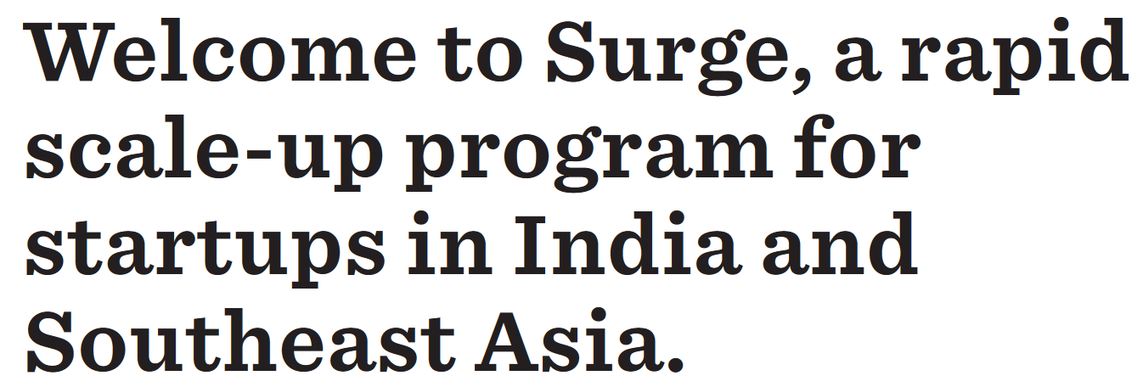
https://www.surgeahead.com/ landing page

Slide 84
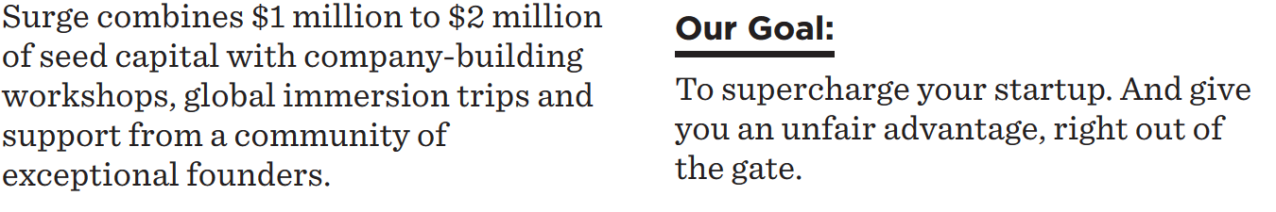
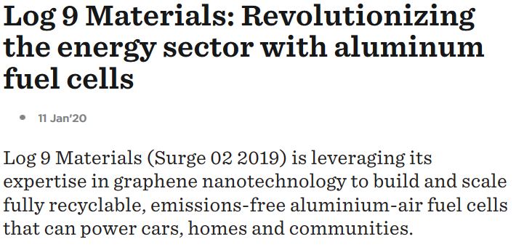
https://www.surgeahead.com/ landing page

Slide 85
Estimating Requirement of Fund

Slide 86
Project Cost
Year | 1 | 2 | 3 | 4
Investment in land and building | 10
Investment in machinery | 100
Other expenses such as electrical connection (transformer), licenses, approach road, disposal arrangement | 20
Investment in trial production | 5
Contingency | 10
Total investment in fixed assets | 145
Turnover | 200 | 250 | 300 | 400
25% of turnover | 50 | 62.5 | 75 | 100
Working capital requirement (Turnover method) | 50 | 62.5 | 75 | 100
Project cost | 190
Working Capital
Fixed Capital

Slide 87
Working Capital (WC): Holding Period Method
 |  | Annual Cost | Holding Period | Value thereof
Raw-Materials | Purchase cost plus transportation. | 600 | 1 month | 50
Goods-in-Process | Cost of production: Raw materials, labor, interest | 720 | 0.5 m | 30
Finished Goods | Cost of production: Raw materials, labor, interest, | 840 | 1.5 m | 105
Receivables | Cost of sales: Raw materials, labor, interest, selling and administrative expenses. | 1200 | 2.5 m | 250
Creditors | Total requirement of WC | 540 | 1 m Total | (–) 45 370

Slide 88
Requirement of Fixed Capital Investment:
Requirement of Working Capital Investment:
Margin Money to be brought in by founders:

Slide 89
Funding Through Equity
Issues
Pros
No interest payment obligation. [If you raise ₹100 of debt (loan from bank) you have to pay ₹15 of interest in a year: assuming rate of interest is @ 15%. Raise the same money through equity, you don’t have to pay any interest].
Comes with mentoring by the angels.
No repayment of the money received.
Cons
Dilution of holding by founders
Payment of dividend
There may be undesirable interference by investors.

Slide 90
Sources of Equity
Founders’ contributions to business are mostly in the form of equity., though at times, founders can lend money to the company as unsecured loan or preference capital.
Incubator
Accelerator
High Net-Worth Individual
Impact investors
Business Angels
Venture Capital Funds
Private Equity Fund

Slide 91
Project Report
Need for fund (create long term and short term assets to maintain business operation)
Sources of financing (equity, debt, and grants)

Slide 92
Business Angel – Angel Investor
Venture Capital fund – VC
Structuring a deal

Slide 93
Business Angels or Angel Investors: Who Are Angel Investors?
An angel investor is an individual who has surplus fund and provides capital to an early stage startup in exchange for part ownership. Invests personal capital in start‐ups
Angels usually support at the early stage when the risk of failure is higher compared to more matured stage.
Usually they are experienced in particular domain or new venture creation in general and have a good perspective of the likely success of a venture.
They take calculated risks, mentor the ventures closely, take all necessary actions for it to succeed.

Slide 94
Who Are Angel Investors?
Business Angels are individuals, invest personal capital in start‐ups
The prototypical business angel …
is in the middle age; has high income and wealth; is well‐educated;
has succeeded as an entrepreneur;
is interested in the start‐up process.
Business angels are valuable because of their willingness to make relatively small investments, giving equity funding to a start‐up needing about ₹ 2.00 million to ₹ 10.00 million.
Venture capitalists usually fund above ₹ 50.00 million per unit.

Slide 95
In recent time, angels also work in group or in network / consortium to neutralize risks.
Individual members may bring in key skills and connections.
In the last 50 years the number of angel investors has greatly increased.
There is no set upper limit that an angel would like commit per venture.

Slide 96

Angel Investors
Usually successful entrepreneurs
Identify potentially winning startup
Closely mentor
Have surplus fund
Supplement required key skilla
Experts in some field
Connect with market
Want to enjoy the excitement of venture creation
Connect with other investors
Ready to absorb high calculated risk

Slide 97
Factors to consider while raising money: When and How Much to Raise?
Conventional wisdom has it that entrepreneur should bootstrap and leverage every strand of non-diluting funding source to increase value in the business before raising fund from angels.
But understand the values that BA can bring. The knowledge, experience, and connection with market & other investors.
Look for seed fund (seed round) to cover beta testing of prototype (public test) and generate the first MVP.
Amount in one round should be enough to take the venture to the next milestone. High-growth venture may raise more money to avoid delay in processing next round of funding.

Slide 98






Investment Negotiation Stages:
Business Angel (BA) and Venture Capitalist (VC) share similar stages to close an investment round
Deal Negotiation & Agreement
Deal Structuring
Deal Evaluation
Deal Screening
Deal Origination
01
02
03
04
05

Slide 99
Common Reasons for Rejection of Investment Proposal by Angel
Business located outside the geographical reach of BA investors.
Stage and type of venture: for example, long pre-revenue and product development phase.
Unattractive sector or market: for example, low margins and high volatility (retail, hotels, restaurants, property); highly competitive or high technical risks or both (e.g. consumer goods, telecom, clean tech, drug development, computer hardware).

Slide 100
Other Common Reasons for Rejection
Limited scalability or growth potential: for example, traditional service business.
Weak business model: unclear value proposition; no clear customers; weak customer channels; no “go-to-market” strategy; insufficient profit margins; lack of exit potential.
Size of initial investment and estimated total funding requirements exceeds capabilities of investor.
Management team is weak, unconvincing, or has poor reputation.
Investment is not eligible for tax relief (for example: the new Start-up India incentive scheme).

Slide 101





De-Risking The Deal! Preserve equity by de-risking the deal
You only raise enough money to get to the next proof point.
At early stage: technology & team risk.
As you go-to-market: execution risk, market acceptance risk, team
Growth phase: risk associated with cost of manufacturing, marketing channel, skilled manpower, adequate finance, competition.
Valuation
RISK
Time

Slide 102
Deal Structuring
Term Sheet
If investors are happy at the end of the presentation they make formal offer in the form of “Term Sheet”.
The conditions in the term sheet are non-binding on investors.

Slide 103
Term Sheet
• Basic terms/conditions of an investment at the minimum:
– Pre-money valuation
– Amount of investment
– Form of investment
– Use of proceeds
– Term and mode of exit
• Non-binding on investor
Exclusivity or no-shop clause

Slide 104
Term Sheet
Terms in the term sheet are negotiable but with fairly significant limitations.
Make deals based on future market and not based on past deal.
They are hard bargainers and may be posturing.
Be consistent and don’t bluff; you may meet again; leave ego out of the deal.
Try to have a short time horizon before it gets stale.

Slide 105
Due Diligence
You, your team and your company are under a microscope.
Legal, financial and strategic review of organizational structure, history, contractual relationships and documents.
Will be tedious, frustrating, time consuming and costly.
Key to success: preparation and cooperation.

Slide 106
Due Diligence – Art and Science
The “Art”
– What to ask, how to ask, when to ask.
– DD team is on a “search and destroy” mission.
Search for problems.
Destroy (eliminate) concerns or fairly allocate.
The “Science”
– Comprehensive list of questions to ask.
– System to organize and analyze data provided.
– Quantitative analysis of risks uncovered.

Slide 107
What are They Looking for?
Overdue tax liabilities.
Inadequate systems.
Related-party transactions.
Unhealthy reliance on customers/suppliers.
Overdue accounts or unrecorded liabilities.
Immediate need for major expenditures.

Slide 108
Define Venture Capitalist and Venture Capital
A venture capitalist (VC) is a private equity investor who pool funds from various investors and provides capital to companies exhibiting high growth potential in exchange for an equity stake.
Venture capital is a form of risk capital that fund startup companies and small businesses that are believed to have long-term growth potential or companies that have grown quickly and appear poised to continue to expand.
Venture capital generally comes from well-off investors, investment banks and any other financial institutions.

Slide 109
Angels and VCs
An angel investor works alone or in group, while venture capitalists are part of a company.
Angels invest smaller sums and investment decisions are quick.
They have different responsibilities and motivations; Angel do get personally involved, but VCs usually get inextricably associated.
Angel investors only invest in early-stage companies. VCs look for proven track record.
They differ in due diligence. VCs are more formal & meticulous.

Slide 110
Preference Shares
Preference shares represents quasi equity capital.
It has features of both equity and debt.
It does not give voting right to the holders.
Fixed rate of dividend, but are performance-driven.
It carries preferential rights over ordinary equity shares in sharing of profits and also claims over assets of the firm.
Thus, it is ranked between equity and debt as far as priority of repayment of capital is concerned.

Slide 111
Pre-money And Post-Money Valuation
Pre-Money
₹5,00,000
Angel-1 brings in
₹10,00,000
Post-Money value
₹15,00,000
Founders’ holding: 5,00,000/15,00,000 = 33.33%
Investor’s holding: 10,00,000/15,00,000 = 66.67%
Pre-Money
₹100,00,000
Angel-2 brings in
₹45,00,000
Post-Money value
₹1,45,00,000
Percentage holding is based on negotiation. It is not calculated based on investment committed
Investor’s holding = 45/145 = 31.03%
Founder & Angel-1= 68.97%

Slide 112
Distribution of Money in the Case of Exit
Usually, money is distributed based on percentage holding.
But some BA and most VCs structure the deal in a manner that they receive the lion’s share of the sales (of the company) proceeds.
The distribution depends on three terms:
Liquidation preference
Participation
Forms of securities

Slide 113
Two Features of Preference Shares
Liquidation preference (how they decide to get their principal money back)
Options
no liquidation preference – no principal repayment.
1X liquidation preference: get exactly what they invested.
nX liquidation preference: getting ‘n’ times the money they invested.
Participating & Non-Participating (receiving money proportional to % holding in the venture)
Both options are available concurrently.
Say 2X liquidation preference AND participating preference share holder: Investor receives 2 times the money they invested and receives part of the remaining money proportionate to their holding in the venture.

Slide 114
Liquidation Preference
It states how the proceeds from liquidation event such as trade sale, initial public offering, or dissolution of company will be distributed.
All VCs and some BAs provide this clause.
In liquidation events, investors will be entitled to their investment and a minimum return ahead of founders.
VCs will often set a liquidation preference such 1X, 2X, or 3X.
Only after distribution of proceeds of liquidation to preferred shareholders—in accordance with respective liquidity preferences—the remaining proceed (if any) is distributed among common shareholders.

Slide 115
Participating Preference Shares
Preferred share (non-participating) – Investors get their money back.
Preferred share with liquidity (1X, 2X or 3X) preference – Investor receives 1X (2X or 3X) times their money.
Participating preferred equity with or without liquidity preference. Participating means if they hold 25% equivalent of equity in preferred stock they receive back their investment plus pro rata (25%) of the remaining money.

Slide 116
Participating Preference Shares with assumed 1x liquidation preference
Participating preferred shareholders not only receive back the amount originally invested along with unpaid dividends upon liquidation, but also part of the remaining assets as if they held common shares.
A new venture raises ₹ 50 million at a pre-money valuation of ₹ 50 million with equity percentage split 50%-50%.
The venture realizes a liquidity event and is acquired for ₹ 250 million.

Slide 117
Example cont’d.
The BA/VC holding participating preferred stock will receive their original investment of ₹ 50 million (liquidation preference) plus 50% of the remaining amount as they hold 50% ownership (participating) in the company.
The entrepreneur would receive ₹ 100 million.
250M – [50M + 0.5X200)] = 250M – 150M = ₹ 100M
[If BA/VC held “convertible preference shares”, post conversion, the BA/VC and the entrepreneur would receive 50% of the exit proceeds or ₹ 125.5 million each.]
However, with lower exit value, the share of the entrepreneur will go down faster.

Slide 118
Anti-dilution Clause
Usually, the valuation of the company is expected to go up moving forward and thus, the per-share value. But, there may be situation when the valuation goes down.
If the investee company issues stock at a price lower than what the existing shareholders paid, the former has to compensate the later by issuing new shares at a price such that the average price of their holding is not more than that of the subsequent round of funding.
Average acquisition price
Percentage holding

Slide 119
Anti-dilution Provision
A company avails investment from an angel ABC by issuing preference shares. Subsequently, the company issues preference shares to another investor XYZ at a lower valuation, the existing shareholders i.e. ABC has the right to be compensated by granting additional shares at a price such that the average price of acquisition is not more than the new issue price.
The existing investors may also insist on maintaining percentage holding in the company through fresh investment along with the new investors.
Antidilution may be so structured that it would be automatically triggered in case of failure to meet milestones.
If the investors do not subscribe to new equity, the antidilution protection may not be available.

Slide 120
Other Preference
Drag-along provisions – it grants investors the right to compel the founders and other shareholders to vote in favor of the sale, merger, or other “deemed liquidation”.

Slide 121
An Example of Preferred Shares
A BA group invests ₹ 50 million for 25% of a venture. The venture is sold for ₹ 100 million.
Case I: no liquidity preference
The BA group would receive ₹ 25 million and lose 50% of their original investment. The entrepreneur or common shareholders would receive ₹ 75 million.
Case II: BA group has a 1X liquidity (non-participating) preference
The BA group would receive ₹ 50 million. The entrepreneur or common shareholders would receive the remaining ₹ 50 million.
Case III: BA group negotiates a 1X ‘participating preference’
The BA group receives their ₹ 50 million plus another ₹ 12.5 million (25% of the remaining ₹ 50 million). The entrepreneur or common shareholders would receive only ₹ 37.5 million.

Slide 122
Another Example of Preferred Shares: Further clarified.
A BA group invests ₹ 50 million for 25% of a venture. The venture is sold for ₹ 100 million.
Post money valuation: 50M/0.25 = 200M
Premoney valuation = 200M – 50M = 150M
Case I: no liquidity preference
The BA group holds 25% of equity in the company. With no liquidation clause, they would receive only 25% of the proceeds: i.e. 25% of 100 M = ₹ 25 million.
Their original investment is ₹ 50 million. So, they lose 50% of their original investment.
The entrepreneur or common shareholders would receive ₹ 75 million.
Repeat slide: may ignore

Slide 123
An Example of Preferred Shares Further clarification… contd.
Repeat slide: may ignore
A BA group invests ₹ 50 million for 25% of a venture. The venture is sold for ₹ 100 million.
Post money valuation: 50/0.25 = 200
Premoney valuation = 200 – 50 = 150
Case II: BA group has a 1X liquidity preference (but not participating)
The 1X liquidation preference means that the BA group would receive one times the investment, which is equal to 1X50 = ₹ 50 million.
Since it is not participating preference shares, the BA does not get a share of the remaining money.
The entrepreneur or common shareholders would receive the remaining ₹ 50 million.

Slide 124
An Example of Preferred Shares Further clarification … contd.
Repeat slide: may ignore
A BA group invests ₹ 50 million for 25% of a venture. The venture is sold for ₹ 100 million.
Post money valuation: 50/0.25 = 200
Pre-money valuation = 200 – 50 = 150
Case III: BA group negotiates a 1X liquidation ‘participating preference’
The 1X liquidation clause gives the BA: 1X50 = ₹ 50 million.
The Participating clause gives the BA group 25% of the remaining money of (100 – 50 = 50) = 50 X 0.25 = 12.5 M.
The founders receive the remaining 37.5 M.

Slide 125
… contd. Case IV: Suppose the VC has a 2X ‘participatory liquidity preference’ in the above case:
On liquidity event, the VC will get 2 times its investment plus their percentage equivalent of the rest of the money.
In this case, VC gets 2 times 50 M, i.e. 100M plus 25% of the rest, which is zero.
The founders and employees holding equity get nothing (the valuation 100M, whereas their holding is 75%).
Therefore, it is not percentage holding that matters. One has to read between lines.
Repeat slide: may ignore

Slide 126
In the above example, let us change only the value at which the company is sold and see how the money is distributed:
Suppose, the venture is sold for ₹400M, 2X participatory liquidity preference would give the BA:
2X liquidation gives 2 times the investment = 2 X 50 = ₹100M
Participatory clause gives the BA 25% of the remaining amount of 300M = ₹75 M
Thus, total receipt by BA = 100 + 75 = ₹175M.
The founders would receive the remaining sum of ₹225M (400 – 175)

Slide 127
Increase the value further and see the shares of proceeds
Suppose, the venture is sold for ₹1000M, 2X participatory liquidity preference would give the BA:
2X liquidation gives 2 times the investment = 2 X 50 = ₹100M
Participatory clause gives the BA 25% of the remaining amount of 900M = ₹225 M
Thus, total receipt by BA = 100 + 225 = ₹325M.
The founders would receive the remaining sum of ₹675M (1000 – 325)M

Slide 128
Moving forward, all convertibles get converted.
Preference shares and convertible debts get converted into equity shares.
All that the investors have is the percentage holding in the company and they received proportional amount in liquidation event.

Slide 129
Debt fund
Funding for innovation
Government schemes

Slide 130
Convertibles
Convertible debt – investment made as debt is subsequently converted into equity, usually preferred equity, when the investee company raises the next round of funding.
The valuation is determined by the next round of investors.
Depending on the risk perception, discount may be allowed on valuation during conversion to shares - roughly in the range of 10% to 30% strictly based on the terms in the term sheet.

Slide 131
Example
An angel (Angel 1) agrees to invest ₹ 6 million in a startup (say ABC) as convertible debt and negotiates a 20% discount.
The meaning of the above is that the debt will be converted into equity at some future date at a price that is less than 20% of the price at which the company will issue shares to another investor(s).
Suppose, during the next round of financing a VC (say VC 1) values ABC at ₹ 100 per share (par value or face value of Rs. 10).
A discount of 20% is allowed to ‘Angel 1’ on the price of ₹ 100 per share. i.e. the ‘Angel 1’ will be able to covert ₹ 6 million into equity shares at a valuation of ₹ 80 per share.
So ‘Angel 1’ will receive ₹6M/₹80 = 75,000 shares of the company.

Slide 132
Convertible Debt Advantages and Disadvantages of Investee Company
Advantages
Disadvantages
Funding does not dilute equity.
Can avoid estimating pre-money valuation.
Chances of lower dilution after value accretion.
Can avoid bias of earlier valuation when approaching to subsequent investors. Avoid down round.
Less processing and quick disbursal.
Investor may opt not to convert
May have to pay interest on debt and stress cash flow.
May lead to higher dilution for the same amount of fund if it fails to meet performance milestones.
Higher discount rate may lead to higher dilution.
If there is ‘cap’ on premoney valuation, the investee company may not avoid dilution.
No voting right

Slide 133
Convertible Debt with Cap
In case of very high valuation by a subsequent investor, the conversion of debt into equity may be at a high price (even after discount), leading to smaller holding by the original investors than anticipated, who actually contributed to the growth of the business.
Therefore, a maximum value may be fixed at which the debt will be converted.
In the example above, suppose the ‘Angel 1’ originally puts a cap of ₹50 per share for conversion of debt to equity. This means, the company has to convert debt of ‘Angel 1’ into equity at price below or equal to ₹50 though shares are being offered to the ‘VC 1’ at ₹100 a piece.
Suppose, ‘VC 1’ is being offered equity shares at ₹40, ‘Angel 1’ will receive the same share at 20% discount, i.e. @₹32.

Slide 134
Supports from the Government through Various Schemes

Slide 135
Startup in India
An entity is defined as a startup if its headquarter is in India, less than 10 years old, and an annual turnover of less than ₹100 crore (US$14 million).
The government has launched the I-MADE program under this initiative to help Indian entrepreneurs build 10 lakh (1 million) mobile app start-ups, and
The MUDRA Bank's scheme (Pradhan Mantri Mudra Yojana aiming to provide micro-finance, low-interest rate loans to entrepreneurs. Initial capital of ₹20,000 crore has been allocated for this scheme.
Startups and Entrepreneurs @ 1 MILLION STARTUPS
www.1millionstartups.com
https://www.startupindia.gov.in/content/sih/en/startup-scheme.html

Slide 136
Definition of Startup for Availing Government Schemes
An entity shall be considered as a Startup:
Up to a period of ten years from the date of incorporation/ registration. Splitting up or reconstructed entities from existing ones are not eligible.
Recognition is done by the Department for Promotion of Industry and Internal Trade (DPIIT).
Turnover of the entity for any of the financial years since incorporation/ registration should not exceed Rs. 100 crore.
Entity is working towards innovation, development or improvement of products or processes or services, or if it is a scalable business model with a high potential of employment generation or wealth creation.
https://www.startupindia.gov.in/content/sih/en/startup-scheme.html

Slide 137

DPIIT Recognition
Under the Startup India initiative, eligible companies can get recognised as Startups by DPIIT, in order to access a host of tax benefits, easier compliance, IPR fast-tracking & more.

Slide 138
Government Supports for Prototyping
1. Department of Scientific & Industrial Research www.dsir.gov.in
Promoting Innovations in Individuals, Start-ups and MSMEs (PRISM): ₹ 2 lakh, ₹ 20 lakh and ₹ 50 lakh of grants in phases.
Patent Acquisition and Collaborative Research and Technology Development (PACE)
2. TIFAC and SIDBI - https://tifac.org.in/
SRIJAN scheme: Low-cost fund up to Rs. 10 million (1.00 crore) is provided by TIFAC through SIDBI. A rolling fund of Rs. 30 crore has been created by TIFAC that is dispensed and monitored by SIDBI.
3. Ministry of Small & Medium Enterprises (MSME) https://msme.gov.in/

Slide 139
PRISM
Phase - I
Category-I: Proof of Concept/ Prototypes/ Models
For prototyping ideas and testing hypothesis
Any Indian national including students can apply.
Maximum support ₹2.00 lakh (subject to 90% of the total requirement)
Form: Grant (no repayment obligation)

Slide 140
PRISM
Phase - I
Category-II: Fabrication of working model/process know-how/ testing and trial/patenting/technology transfer etc. (Innovation Incubation)
For fabrication, refinement and validation of prototypes.
Any Indian national can apply.
Maximum support ₹20.00 lakh (subject to 90% of the total requirement).
Form: Grant (no repayment obligation).

Slide 141
PRISM
Phase - II
Enterprise Incubation
The support is for scaling up technology based innovations, patenting/design registration/trademark registry/ technology transfer to develop a marketable product/process towards enterprise creation.
Successful PRISM innovators or those who have received assistance from any other government scheme and demonstrated success.
Maximum support ₹50.00 lakh (subject to 50% of the total project cost).
Form: Grant (no repayment obligation).

Slide 142
PACE - Patent Acquisition and Collaborative Research and Technology Development - DSIR
The scheme supports development and /or adoption of new technologies or creative/innovative application to solve unmet needs of industry.
For projects in collaboration with R&D organization/ academic institution/ university, support is up to 100% of the project cost.
For projects of industry alone, support is up to 50% of the project cost in the form of secured loan.

Slide 143
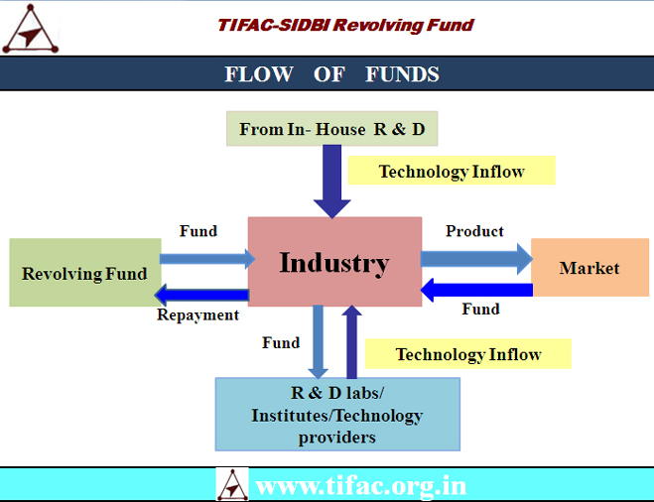

SRIJAN by TIFAC & SIDBI

Slide 144
SRIJAN
Loan assistance is not more than Rs. 10 million for each project.
This is development loan on soft terms & conditions.
The interest rate is not more than 5% per annum (simple).
The repayment shall commence within one year after the project completion and shall be fully repaid in five years.
The duration of the project should not normally exceed 18 months.
The soft loan is limited to maximum 80% of the estimated project cost and the promoter has to contribute minimum 20%.

Slide 145
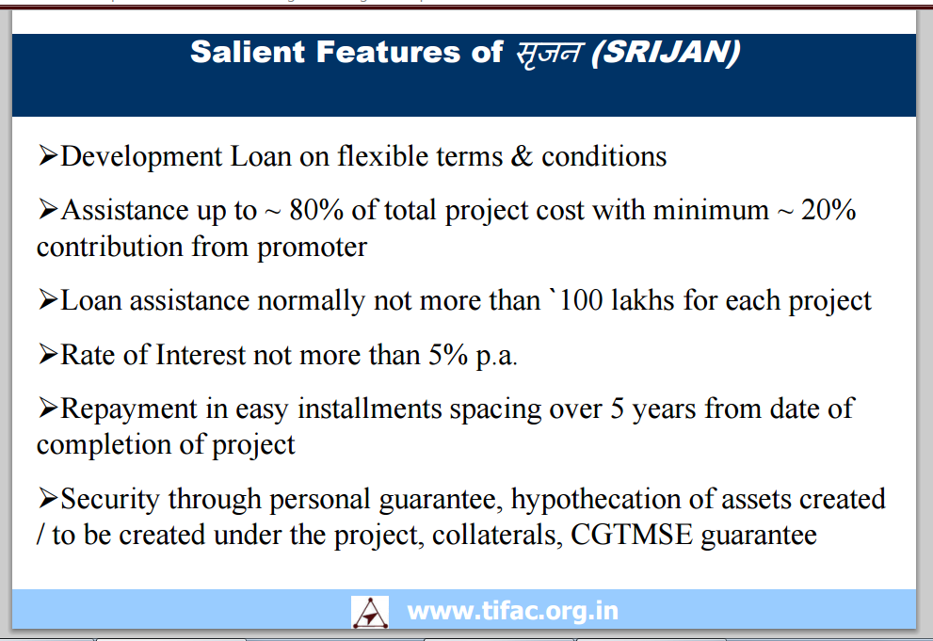

Slide 146
Funds for Prototyping
Besides the schemes of DSIR and TIFAC, several startup funds launched by the Government of India and is administered through the Ministry of Small & Medium Enterprises (MSME).
MSME has many funding schemes to support startups (http://msme.gov.in/ ).

Slide 147
Atal Incubation Centers (AIC)
Atal Innovation Mission (AIM)
AIM will provide a grant-in-aid of INR 10 Cr to each AIC for a maximum of five years to cover the capital and operational expenditures to establish the AIC.
The applicant would have to provide at least 10,000 sq.m. space
https://aim.gov.in/atal-incubation-centres.php

Slide 148
SBIRI of Biotechnology Industry Research Assistance Council (BIRAC) under DBT
SBIRI : The following structure of funding will be available to industry depending on the project cost and own resources brought in by the promoter to the project.
If the actual project cost is up to Rs. 25 lakhs, 80% of the project cost will be available as a government grant.
If the actual project cost is between Rs. 25 lakhs and Rs. 100 lakhs, 50% of the project cost will be available as government grant subject to a minimum of Rs. 20 lakhs and maximum of ₹50 lakhs.
Higher grant is available for collaborative research project.
Notes:
Small Business Innovation Research Initiative

Slide 149
Biotechnology Industry Research Assistance Council (BIRAC)
SEED - Sustainable Entrepreneurship and Enterprise Development Fund to incubators
ACE – Accelerating Entrepreneurs’ Fund [Fund of Funds]
NABARD – fund for incubation agro-based startups.
BIRAC Home
www.birac.nic.in

Slide 150
More Government Schemes
Hardly 5% of MSMEs have access to formal credit. There is almost no possibility of getting credit at idea or early stage of startup.
Indian government has recently rolled out initiatives to offer business loans for startups and MSMEs through authorized channels.
One of the important ones was the recently-launched 59-minute loan platform enabling online easy access to credit for MSMEs.
Furthermore, the Small Industries Development Bank of India (SIDBI) has started lending to companies directly bypassing banks.
The interest rate on these loans is at least 300 basis points lower than the usual rates.

Slide 151
The initiative aims to automate various processes to loan appraisal in such a way that one gets an eligibility letter, in-principle approval in less than 60 minutes and chooses the bank that one may prefer to ease access to credit to smaller and micro enterprises.
You update your credential online, choose the bank you prefer, and receive an in principle approval in 59 minutes.
Actual sanction is expected within 7 to 8 days. Interest rate starts at 8%.
Credit Guarantee Fund Trust for Micro and Small Enterprises (CGTMSE): Loans up to ₹ 1 crore is covered.

Slide 152
A number of other government startup loans and schemes for entrepreneurs in India have been introduced in the past few years. Here is a list of some of the most popular and notable government schemes that offer business loans for startups And MSMEs in India.
New Gen IEDC (Innovation and Entrepreneurship Development Centre) scheme.
Bank Credit Facilitation Scheme
Credit Guarantee Scheme (CGS)
Credit Linked Capital Subsidy for Technology Upgrades
Coir Udyami Yojana
MSME Business Loans For Startups In 59 Minutes
Pradhan Mantri Mudra Yojana (PMMY)
SIDBI Make in India Soft Loan Fund for MSMEs (SMILE)
Standup India
Sustainable Finance Scheme

Slide 153
SIDBI Make in India Soft Loan Fund for MSMEs (SMILE)
Small Industries Development Bank of India (SIDBI)
New enterprises in manufacturing as well as the services sector can apply.
Support 20 lakh or 10% of the project cost.

Slide 154
Comprehensive List Of Venture Capital Funds Managed By SIDBI That Have Catalysed More Than 500 MSMEs And Startups.
SIDBI funds many venture capital funds.
Maharashtra State Social Venture Fund (MS Fund)
Investment Size: Not more than $3.9 Mn (INR 25 Cr) per investee company.
West Bengal MSME VC Fund (WB Fund)
Investment Size: Not more than $1.4 Mn (INR 9 Cr)
India Opportunities Fund
SME Growth Fund
Samridhi Fund
See here for details
https://www.sidbiventure.co.in/

Slide 155
Fund of Funds for Startups
In April 2017, the Union Cabinet, chaired by PM Narendra Modi, approved the establishment $1.4 Bn (INR 10, 000 Cr) corpus for a ‘Fund of Funds for Startups (FFS) proposed by the government in June 2016.
ASPIRE Fund
India Aspiration Fund
SIDBI Make in India Loan For Enterprises (SMILE) Fund
SAARC Development Fund
See here for details
https://www.sidbiventure.co.in/

Slide 156
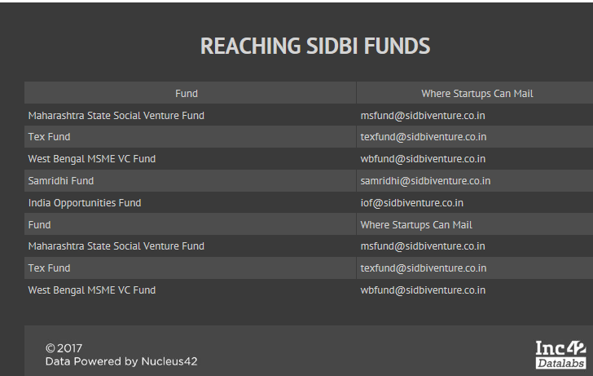

Slide 157
Tax exemption under section 80 IAC
The recognized startups are eligible to receive Income Tax exemption.
They enjoy tax holiday for 3 financial years out of its first ten years of operation since incorporation.
Eligibility Criteria (80IAC)
The entity should be a recognized Startup.
Only Private limited companies and Limited Liability Partnerships are eligible for Tax exemption under Section 80IAC
The Startup should have been incorporated after 1st April, 2016

Slide 158
Some Does and Donts
Do not keep information from investors – both positive and negative.
“I like to send out a monthly update to our entire investor base with most of our metrics, regardless of whether they’re good or bad, to further nurture this trust with our partners.” – Giuseppe Stuto
It Maximizes the Probability of Getting the Right Help at the Right Time
It prepares you to accept failure and move on.
It helps the investors to come to your rescue at times of distress.

Slide 159
Financing New Ventures: An Entrepreneur's Guide to Business Angel Investment by Andrew Zacharakis, 2013
Harvard Business Review Entrepreneur's Handbook (HBR Handbooks) Paperback – 23 Mar 2018
https://encycolorpedia.com/
https://unsplash.com/s/photos/background for images
https://www.youtube.com/watch?time_continue=231&v=SB16xgtFmco&feature=emb_logo
https://slidebean.com/templates/investor-deck-template
https://guykawasaki.com/the-only-10-slides-you-need-in-your-pitch/
https://slidebean.com/templates/investor-deck-template
Various Wikipedia pages

Slide 160
Create empathy with the investors, understand their risks and aspirations.
Try eliminating questionable statements.

